Slide 1


.NET 7 and C# 11
What’s new?
Author: Vu.Truong
Source: Github
Dec/2022

Slide 2


TABLE OF CONTENTS
01.
04.
06.
.NET 7
Entity Framework 7
Demo
02.
05.
C# 11
Other updates
03.
ASP.NET Core 7

Slide 3
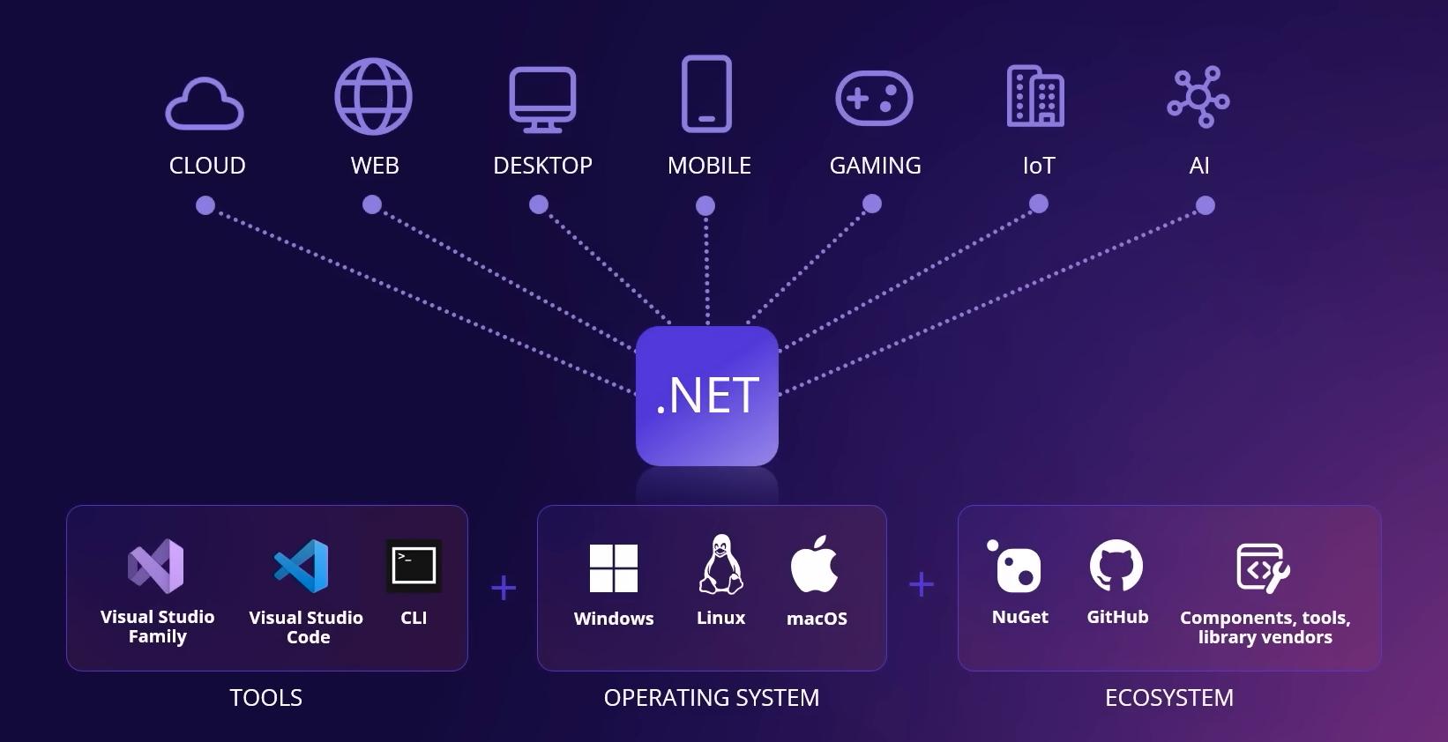

Slide 4


.NET 7
What’s new?

Slide 5
.NET 7 - What’s new?
Performance improvements
Linq
Native AOT
Reflection
OSR, Tiered PGO...
System.Text.Json
Generic Math
Regular expressions
Built-in container support
.NET Libraries
P/Invoke source generation
Hot reload improvements
Tar File APIs
gRPC JSON transcoding
Observability
Copy UTF-8 & UTF-16 Strings
New Roslyn analyzer and fixer for RegexGenerator
Notes:
https://learn.microsoft.com/en-us/dotnet/core/deploying/native-aot/
https://learn.microsoft.com/en-us/dotnet/core/extensions/http-ratelimiter

Slide 6
.NET 7 - Performance
https://devblogs.microsoft.com/dotnet/performance_improvements_in_net_7
Notes:
https://learn.microsoft.com/en-us/dotnet/core/deploying/native-aot/
https://learn.microsoft.com/en-us/dotnet/core/extensions/http-ratelimiter

Slide 7
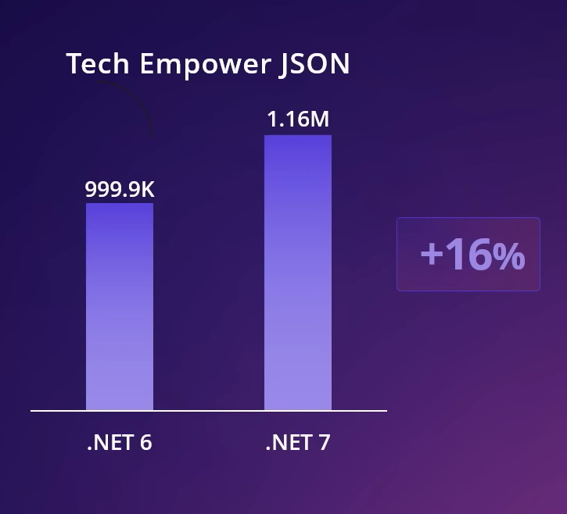
.NET 7 - API Performance
Focus on
Plain text: 8% more RPS
JSON: 16% more RPS
Notes:
https://learn.microsoft.com/en-us/dotnet/core/deploying/native-aot/
https://learn.microsoft.com/en-us/dotnet/core/extensions/http-ratelimiter

Slide 8
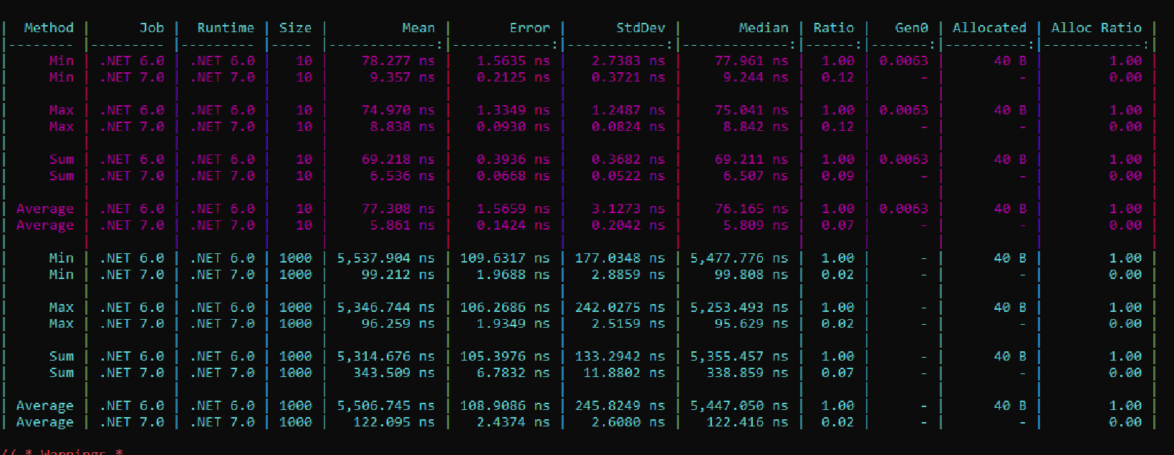
Linq
Linq method improvements:
Notes:
https://learn.microsoft.com/en-us/dotnet/core/deploying/native-aot/
https://learn.microsoft.com/en-us/dotnet/core/extensions/http-ratelimiter

Slide 9
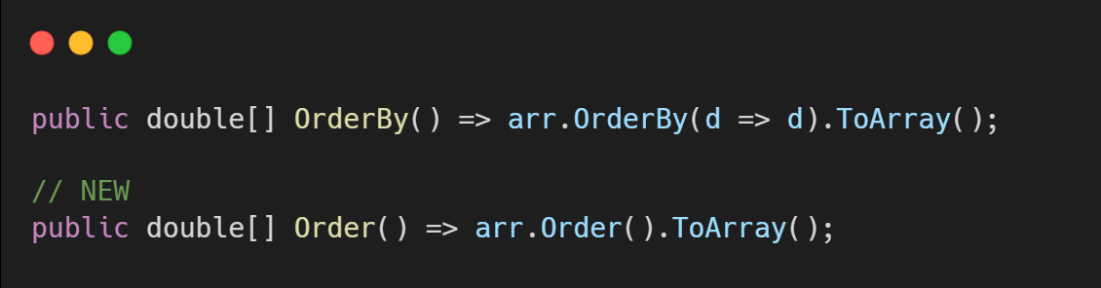
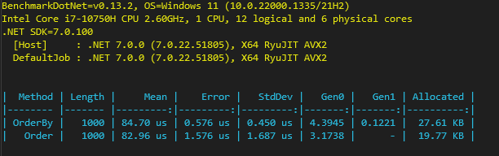
Linq
New Order method
System.Collections.Generic.IComparer<T>
Notes:
https://learn.microsoft.com/en-us/dotnet/core/deploying/native-aot/
https://learn.microsoft.com/en-us/dotnet/core/extensions/http-ratelimiter

Slide 10
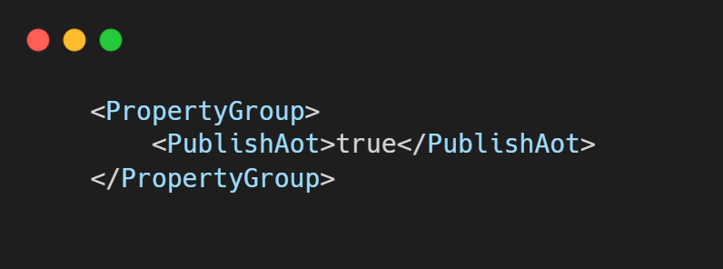
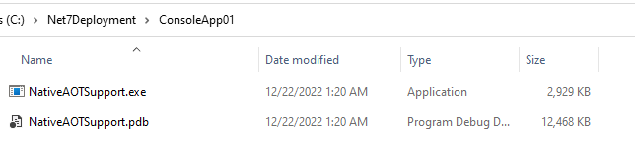
Native AOT
Notes:
https://learn.microsoft.com/en-us/dotnet/core/deploying/native-aot/
https://learn.microsoft.com/en-us/dotnet/core/extensions/http-ratelimiter

Slide 11
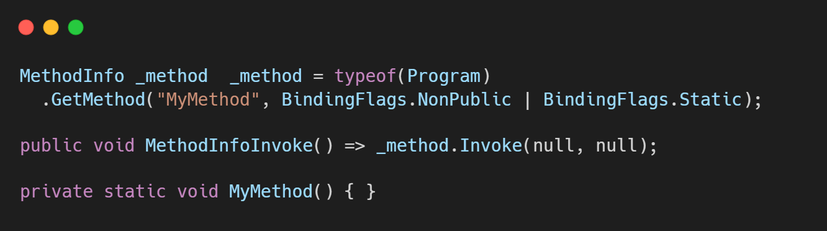
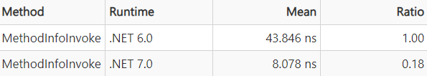
Reflection
Notes:
https://learn.microsoft.com/en-us/dotnet/core/deploying/native-aot/
https://learn.microsoft.com/en-us/dotnet/core/extensions/http-ratelimiter

Slide 12
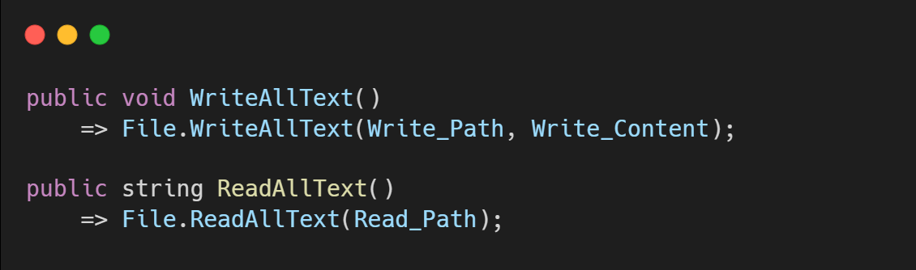
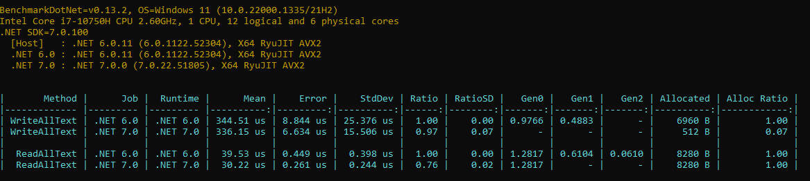
System.IO
Notes:
https://learn.microsoft.com/en-us/dotnet/core/deploying/native-aot/
https://learn.microsoft.com/en-us/dotnet/core/extensions/http-ratelimiter

Slide 13
C#11

Slide 14
C# 11
Static Virtual Member in Interface
Generic Math support
Generic Attributes
String Literals
UTF-8 string literals
New line in interpolations
File-local types
List patterns
Pattern match Span
Required members
Auto-default structs
Extened nameof scope
Improved Method group conversion
Numeric IntPtr and UIntPtr
ref fields and ref scoped variables

Slide 15
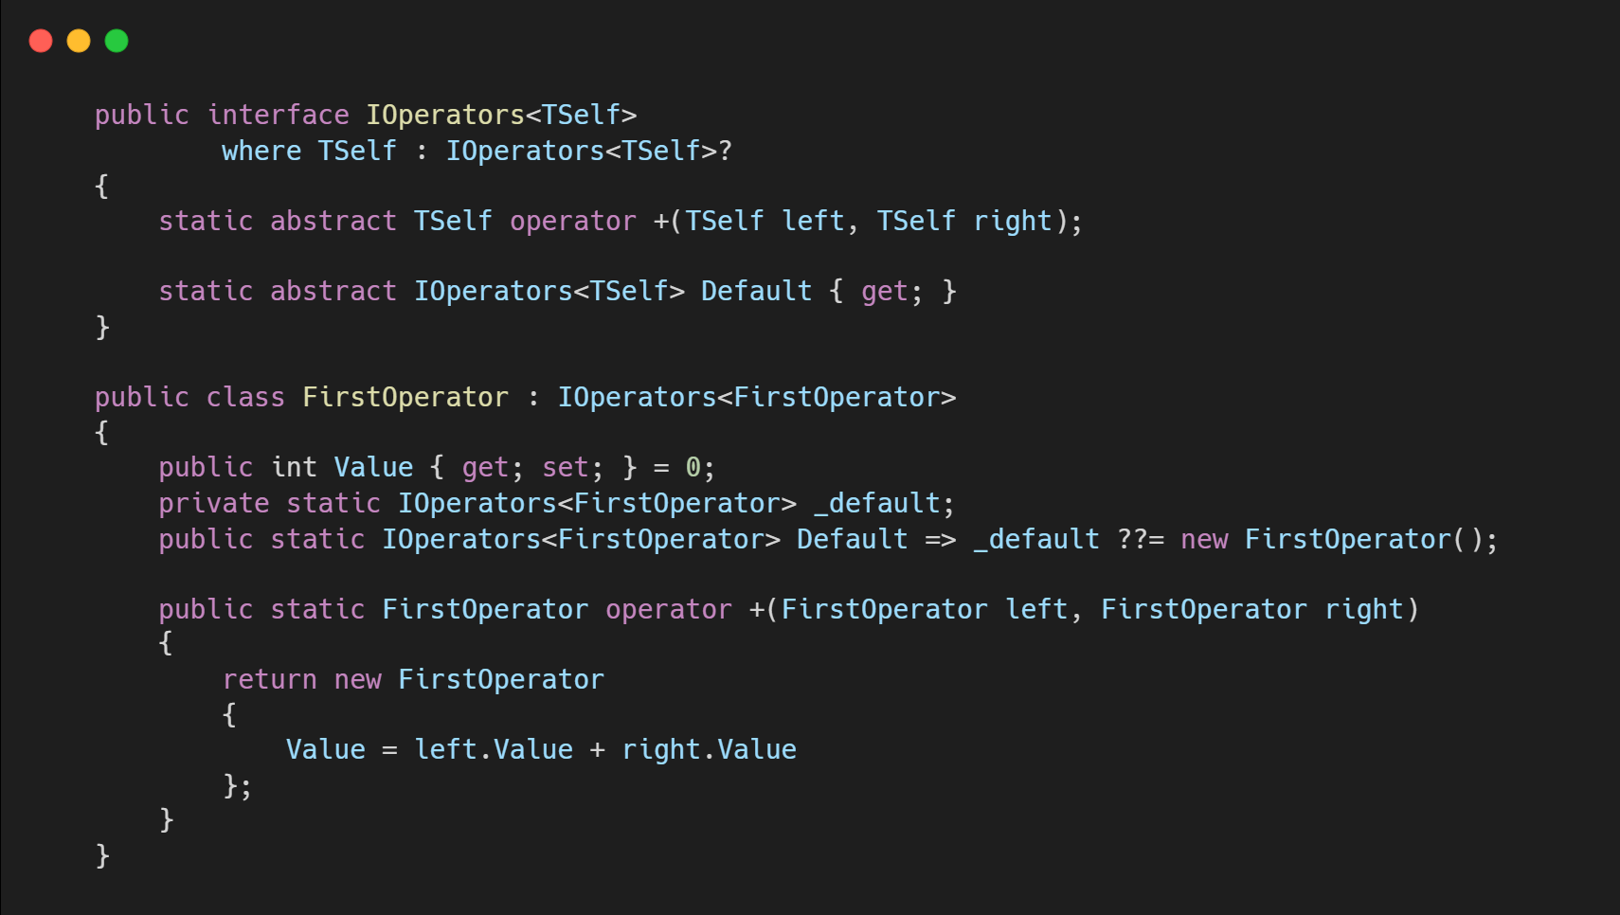
Static Virtual Memeber in Interface
This feature enables you to define interfaces that include overloaded operators or other static members.

Slide 16
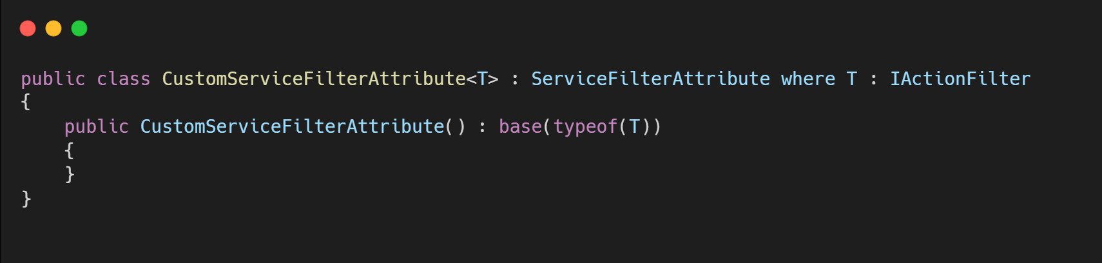
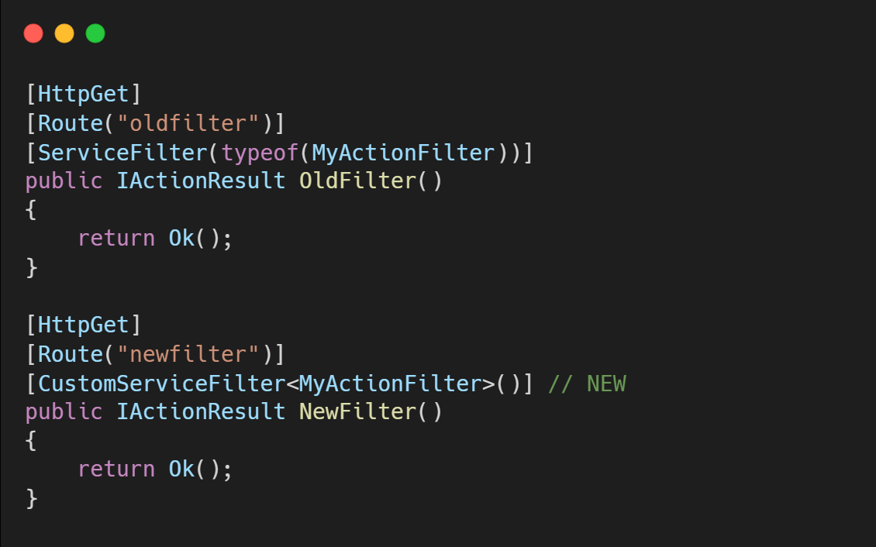
Generic Attributes

Slide 17
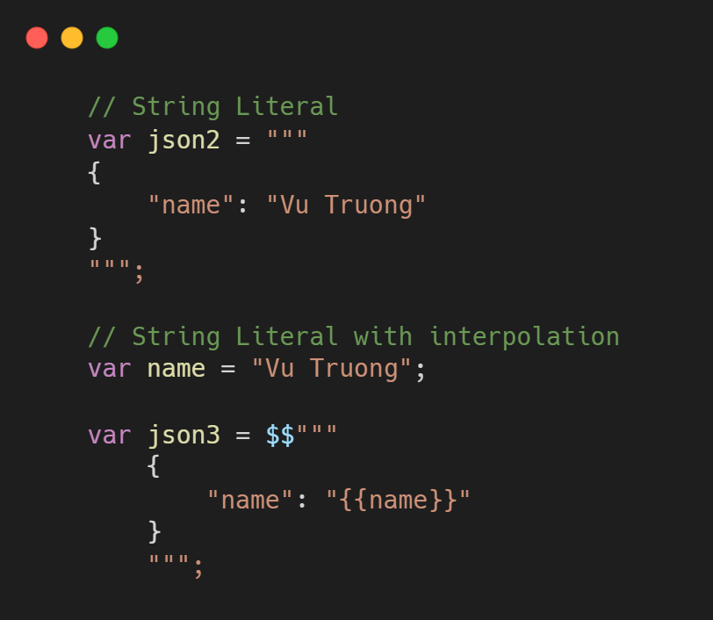
String Literals

Slide 18
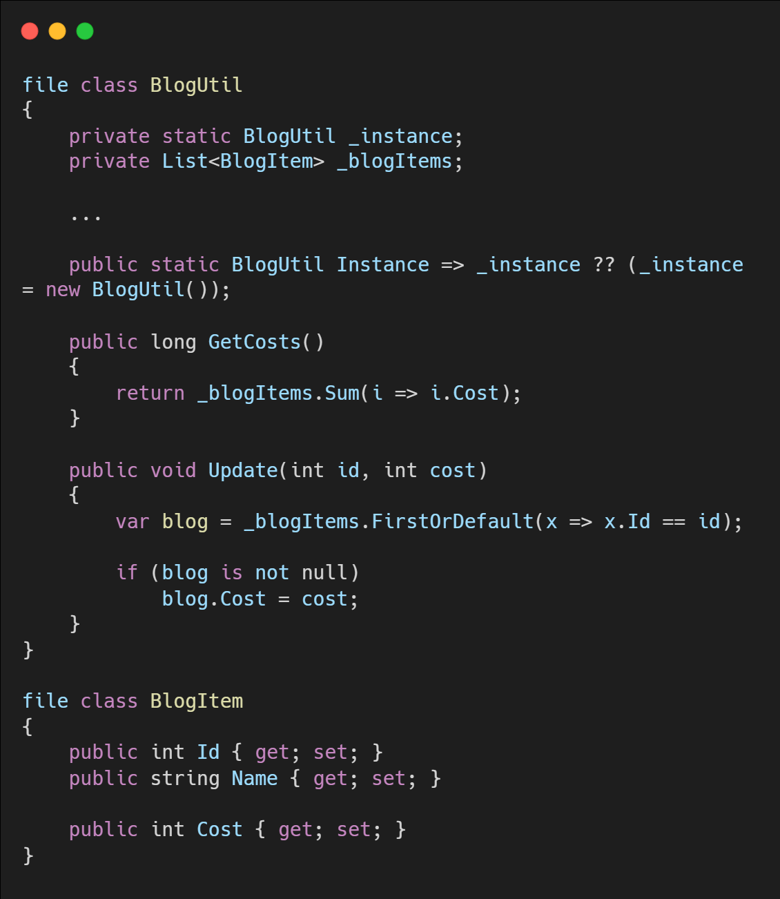
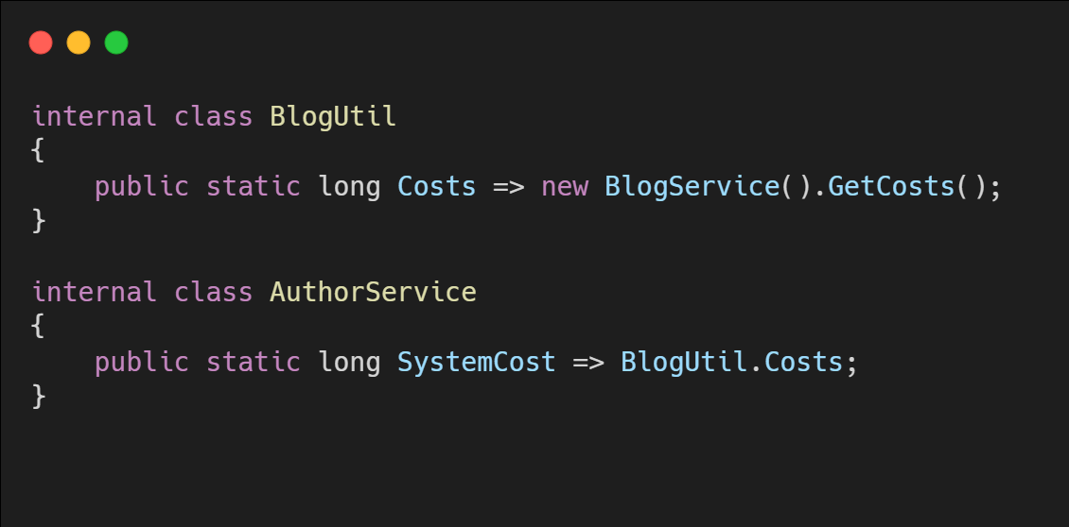
File-local Type
File A.cs
File B.cs

Slide 19
ASP.NET Core 7

Slide 20
ASP.NET Core 7
Rate limiting
Output caching middlewares
Default authentication scheme
Added metrics for Microsoft.Extensions.Caching
Parameter binding with DI in API controllers
Support for nullable models in MVC views and Razor Pages
New problem details service
Kestrel performance improvements
Improve console out for dotnet watch
Developer exception page dark mode
Updated Angular and React templates
Option to use Program.Main method instead of top-level statements
Request decompression
HTTP/3 Improvements
HTTP/2 Performance improvements
HTTP/2 WebSockets support

Slide 21
Rate Limiter
Rate limiting is the concept of limiting how much a resource can be accessed
Fixed window
Sliding window
Token bucket
Concurrency
Notes:
https://learn.microsoft.com/en-us/dotnet/core/extensions/http-ratelimiter
https://devblogs.microsoft.com/dotnet/announcing-rate-limiting-for-dotnet/
https://learn.microsoft.com/en-us/aspnet/core/performance/rate-limit?preserve-view=true&view=aspnetcore-7.0

Slide 22
Output Cache
The output caching middleware enables caching of HTTP responses
The caching behavior is configurable on the server
The cache storage medium is extensible
You can programmatically invalidate selected cache entries
Resource locking mitigates the risk of cache stampede and thundering herd
Cache revalidation minimizes bandwidth usage
Notes:
https://learn.microsoft.com/en-us/aspnet/core/performance/caching/overview?view=aspnetcore-7.0#output-caching

Slide 23
ASP.NET Core 7
Blazor
Web Assembly Experimental
Custom Elements
Hot Reload Improvements
System.Security.Cryptography support on WebAssembly
Experimental QuickGrid component
@bind enhancement
New Blazor loading page
gRPC
RESTful HTTP APIs for gRPC
Built-in support for health checks
Call Credentials
Minimal APIs
Group Routes
Open API improvements
Provide endpoint descriptions and summaries
Filters
Typed Results
File Uploads
New Results.Stream overloads
New HttpResult interfaces
SignalR
Requesting client results
DI for SignalR hub methods

Slide 24
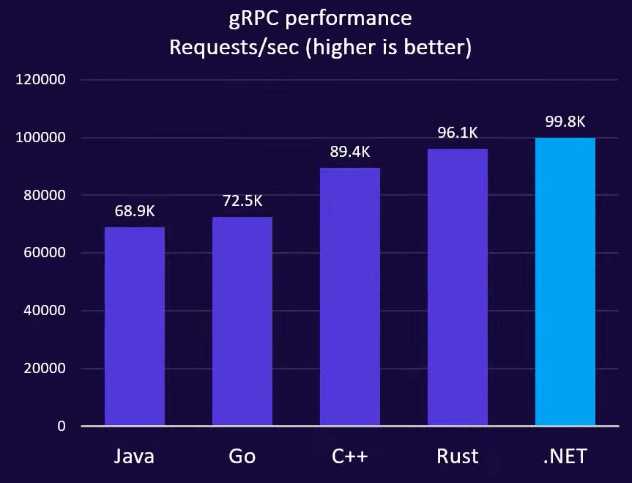
gRPC Performance
HTTP/2 re-architecture
Significant concurrency improvements
Server streaming:
.NET 6 - 0.5 ms RPS
.NET 7 - 4.5 ms RPS (8x increase)
Upload speed: 108mb upload with latency
.NET 6 - 26.9s
.NET 7 - 4.3s ( 6x faster)
Source: https://github.com/LesnyRumcajs/grpc_bench

Slide 25
Entity Framework 7

Slide 26
Entity Framework 7
JSON Columns
ExecuteUpdate and ExecuteDelete (Bulk updates)
Faster Savechanges
Table-per-concrete-type (TPC) inheritance mapping
Model building conventions
Model building enhancements
Stored procedure mapping
Custom Reverse Engineering Templates
New and improved interceptors and events
Query Enhancements
DbContext API and behavior enhancements
Improved value generation
Migrations tooling improvements
Performance enhancements for proxies
First-class Windows Forms data binding
Notes:
https://learn.microsoft.com/en-us/ef/core/what-is-new/ef-core-7.0/whatsnew
https://learn.microsoft.com/en-us/ef/core/managing-schemas/scaffolding/templates?tabs=dotnet-core-cli

Slide 27
Other updates

Slide 28
Other updates
F# 11
Announcing F# 7
.NET MAUI
What's new?
Windows Forms
What's new?
WPF
What's new?
.NET Upgrade Assistant and CoreWCF
ML.NET
What's new?
Introducing the ML.NET Text Classification API (preview)
Orleans
What's new?
Notes:
https://devblogs.microsoft.com/dotnet/use-net-7-from-any-javascript-app-in-net-7/

Slide 29
Q & A

Slide 30
References
https://learn.microsoft.com/en-us/dotnet/core/compatibility/7.0
https://learn.microsoft.com/en-us/dotnet/whats-new/dotnet-7-docs
https://learn.microsoft.com/en-us/dotnet/csharp/whats-new/tutorials/static-virtual-interface-members
https://devblogs.microsoft.com/dotnet/announcing-dotnet-7-preview-5/#analyzer
https://learn.microsoft.com/en-us/aspnet/core/release-notes/aspnetcore-7.0?view=aspnetcore-7.0
https://learn.microsoft.com/en-us/aspnet/core/performance/rate-limit?preserve-view=true&view=aspnetcore-7.0
https://learn.microsoft.com/en-us/aspnet/core/fundamentals/middleware/request-decompression?preserve-view=true&view=aspnetcore-7.0
https://learn.microsoft.com/en-us/aspnet/core/performance/caching/overview?view=aspnetcore-7.0#output-caching
Notes:
Show code về process và validate trong method, gán các giá trị ko đưa vào constant, gán các giá trị không đặt enum

Slide 31

THANK YOU!

